Slide 1

Tranformasi Ke Disain
Pertemuan 5.2
Zyad Rusdi

Slide 2
INTRODUCTION
The design phase decides how the new system will operate.
The design phase develops the system requirements that describe details for building the system.
We also describe three alternative strategies for acquiring the system.

Slide 3
TRANSITION FROM REQUIREMENT TO DESIGN
The purpose of the analysis phase is to figure out what the business needs. The purpose of the design phase is to decide how to build it.
During the initial part of design, the business requirements are converted into system requirements that describe the technical details for building the system.
System requirements are communicated through a collection of design documents and physical process and data models.

Slide 4
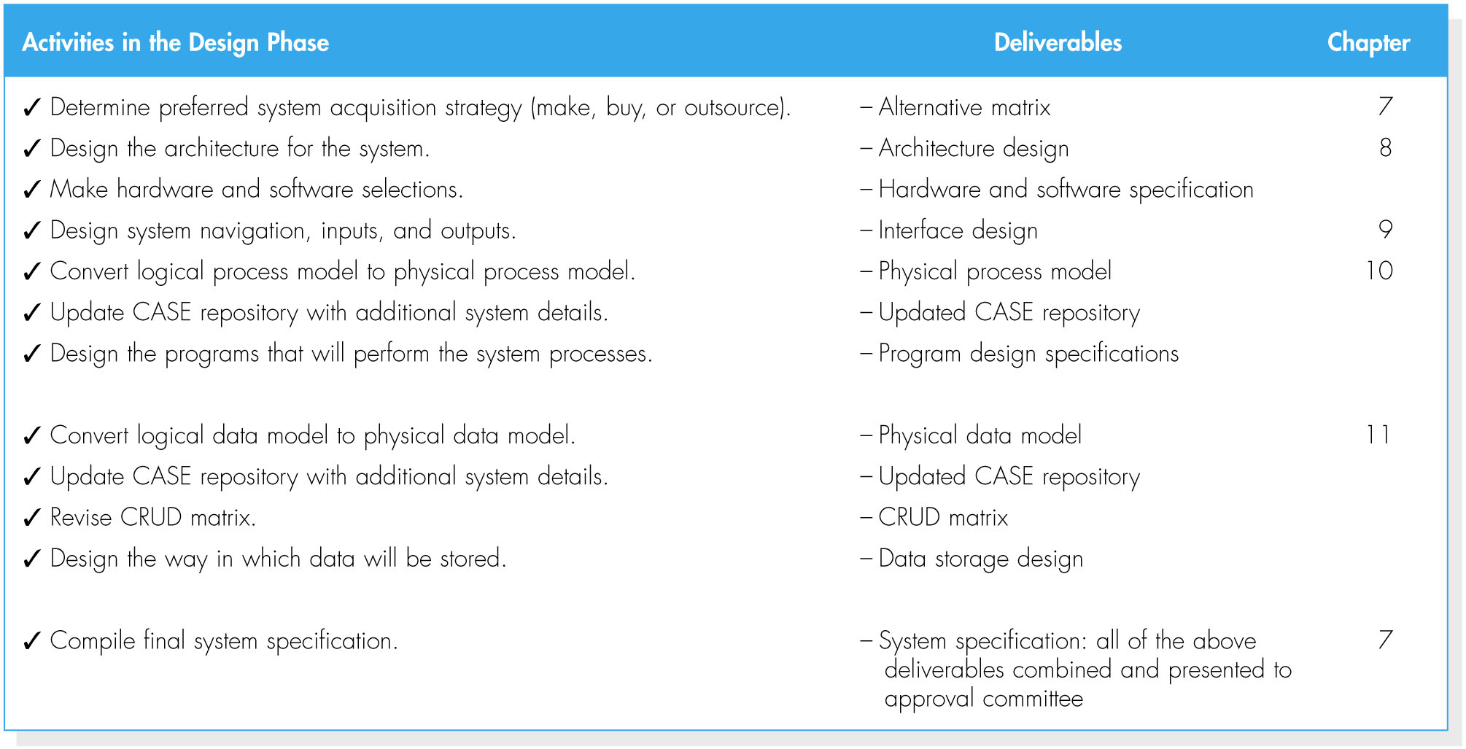
(cont’d)
Activities of the design phase

Slide 5
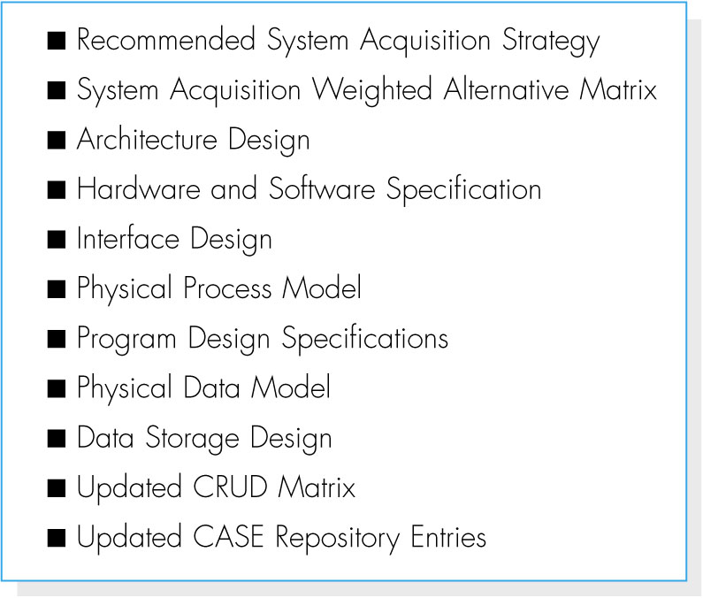
(cont’d)
At the end of the design phase, the final deliverable called system specification is created.
System specification outline

Slide 6
SYSTEM ACQUISITION STRATEGIES
There are three primary ways to approach the creation of a new system:
1. Develop a custom application in-house.
2. Buy a packaged system and (possibly) customize it; and
3. Rely on an external vendor, developer, or service provider to build or provide the system.

Slide 7
Custom Development
Custom development – building a new system from scratch.
Pros of custom development:
- It allows developers to be flexible and creative in the way they solve business problems.
- It allows to take advantage of current technologies that can support strategic efforts.
- It builds technical skills and functional knowledge within the organization.

Slide 8
(cont’d)
Cons of custom development:
- It requires a dedicated effort that include long hours and hard work.
- It requires a variety of skills, but high skilled IS professionals are difficult to hire and retain.
- The risks associated with building a system from the ground up can be quite high.

Slide 9
Packaged Software
Many organizations buy packaged software that has been written for common business needs.
It can be much more efficient to buy programs that have already been created and tested, and a packaged system can be bought and installed quickly compared with a custom system.
Packaged software can range from small single-function tools to huge all-encompassing system such as ERP (enterprise resource planning) applications.

Slide 10
(cont’d)
One problem of packaged software is that companies utilizing packaged software must accept the functionality that is provided by the system.
Most packaged applications allow for customization or the manipulation of system parameters to change the way certain features work.
A custom-built add-on program that interfaces with the packaged application, called a workaround, can be created to handle special needs.

Slide 11
(cont’d)
Systems Integration refers to the process of building new systems by combining packaged software, existing legacy systems, and new software written to integrate them.
The key challenge in systems integration is finding ways to integrate the data produced by the different packages and legacy systems.

Slide 12
Outsourcing
Outsourcing means hiring an external vendor, developer, or service provider to create or supply the system.
Outsourcing firms called application service providers (ASPs) supply software applications and/or services over the Internet.
Software as a service (SaaS) is an extension of the ASP model.
Outsourcing has many advantages such as a low cost of entry and a short setup time.

Slide 13
(cont’d)
Risks of outsourcing:
informasi rahasia jadi diketahui oleh outcourching
Kehilangan kendali atas pengembangan selanjutnya
Para profesional internal jadi kurang ketermapilannya
Tidak boleh melakukan outsourcing apa yang tidak Anda pahami.
Hati-hati memilih perusahaan outsourcing dengan rekam jejak yang terbukti.

Slide 14
(cont’d)
Three types of outsourcing contracts:
- Time and arrangements: pay for whatever time and expenses are needed to get the job done.
- Fixed-price contract
- Value-added contract: the outsourcer reaps some percentage of the completed system’s benefits.

Slide 15
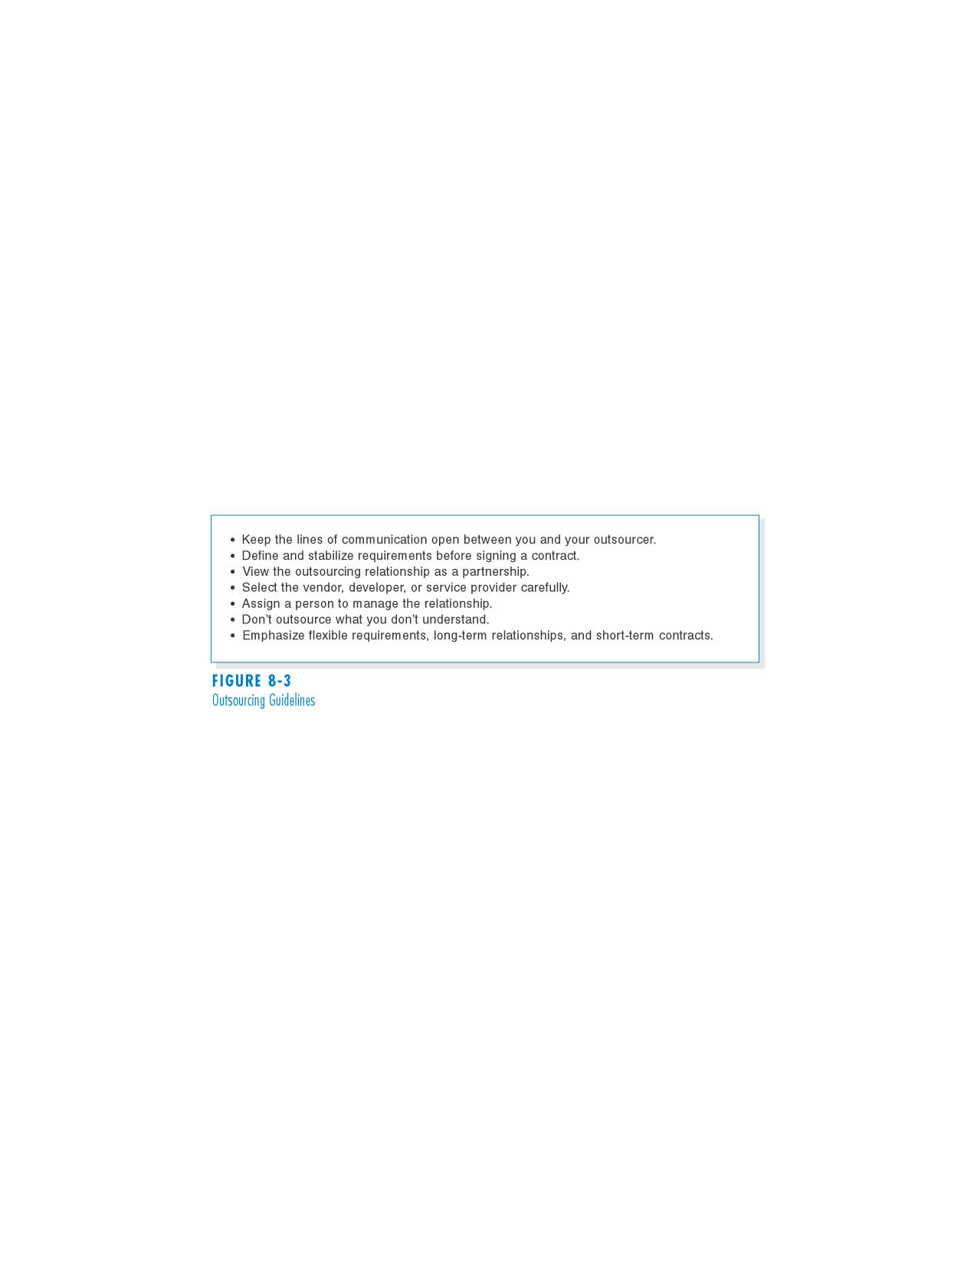
(cont’d)
Outsourcing Guidelines

Slide 16
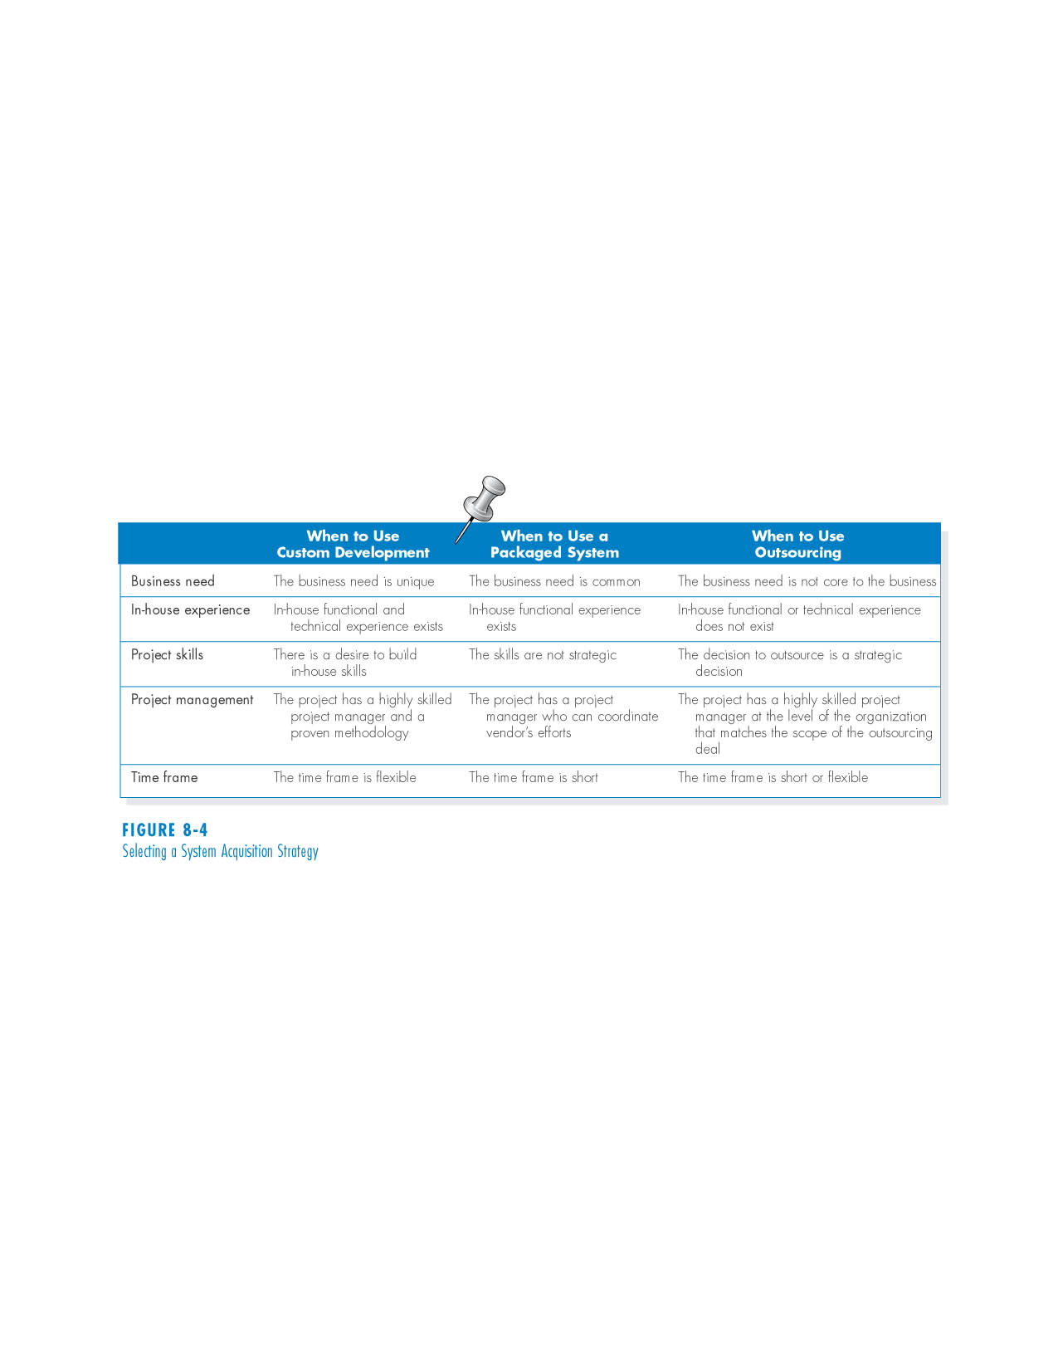
INFLUENCES ON THE ACQUISTION STRATEGY
Project characteristics that influence the choice of acquisition strategy

Slide 17
Business Need
If the business need for the system is common and the technical solutions already exist, packaged software is a solution.
A custom solution should be explored when the business need is unique.
Outsourcing is used in situations where the business need is not a critical element of company strategy.

Slide 18
In-House Experience
If in-house experience exists for all the functional and technical needs of the system, it will be easier to build a custom application.
A packaged system may be a better alternative for companies that do not have the technical skills to build the desired system.

Slide 19
Project Skills
The skills that are applied during projects are either technical (e.g., SQL) or functional (e.g., e-commerce).
Different design alternatives are more viable, depending on how important the skills are to the company’s strategy.

Slide 20
Project Management
Custom applications require excellent project management and a proven methodology.
There are so many things that can push a project off track, such as funding obstacles, staffing, and overly demanding business users.
The project team should choose to develop a custom application only if it is certain that the underlying coordination and control mechanisms will be in place.
Packaged and outsourcing alternatives also must be managed; however, they are more shielded from internal obstacles.

Slide 21
Time Frame
When time is a factor, the project team should probably start looking for a system that is already built and tested.
If a custom alternative is chosen, and the time frame is very short, consider using techniques like timeboxing to manage the problem.
An outsourcing solution could take as long a custom development initiative.

Slide 22
SELECTING AN ACQUISITION STRATEGY
To implement the strategies, additional information is needed.
- What tools and technologies are needed for a custom development project?
- What vendors make products that address the project needs?
- What service providers would be able to build this application if outsourced?
One helpful tool is the request for proposal (RFP), a document that solicits a formal proposal from a potential vendor, developer, or service provider.

Slide 23
(cont’d)
RFPs describe in detail the system or service that is needed, and vendor respond by describing in detail how they could supply those needs.
For smaller projects with smaller budgets, a request for information (RFI) may be sufficient, as it is shorter and less detailed.
When a list of equipment is so complete that the vendor needs only provide a price, a request for quote (RFQ) may be used.

Slide 24
Developing an Alternative Matrix
The alternative matrix combines several feasibility analyses into one matrix.
It contains technical, economical and organizational feasibilities for each system candidate, pros and cons, and other information.
The matrix is a grid with alternatives across the top and different criteria along the side.

Slide 25
(cont’d)
Sometimes, weights and scores are added to create a weighted alternative matrix.
The score assigned is a subjective assignment.
To avoid a biased analysis, each analyst develops ratings independently.

Slide 26
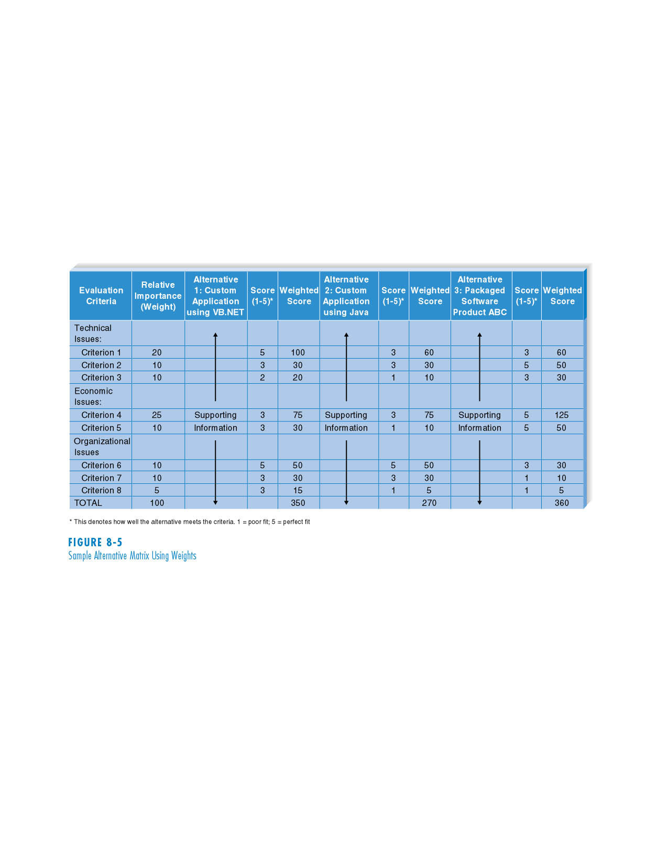
(cont’d)
Sample Alternative Matrix Using Weights

Slide 27
SUMMARY
Transitioning from requirements to design
- The design phase develops the blueprint for the new system.
- The main deliverable from the design phase is the system specification.
System acquisition strategies
- Custom application in-house.
- Packaged system.
- Outsourcing.

